Slide 1
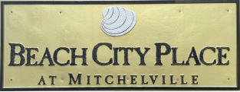
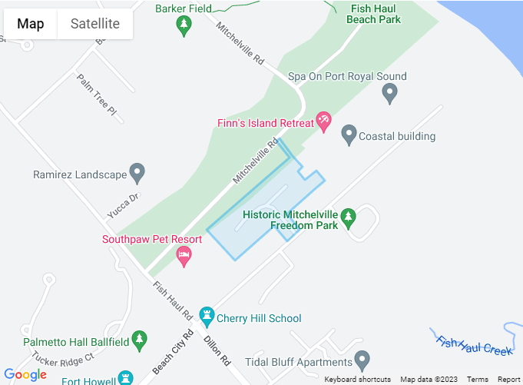
9.16.23
1st Annual community YARD SALE
Saturday 9/16 - 7 to 2

